Slide 1
Lecture 15:
Deep Learning on Point Cloud
Saeed Vahidian, Bingni Guo, Jingwen Liang
Feb 26, 2019

Slide 2
Applications of 3D Data
3D geometry analysis (input)
Classification
Parsing
Correspondence
3D-assisted image analysis (latent)
Cross-view image retrieval
Intrinsic decomposition
3D synthesis (output)
3D reconstruction
Shape modeling
Notes:
Established DL architectures on 2D data showed that they require to use a large amount of training data. Due to this fact, applying DL on the 3D domain was not as effective as 2D. Fortunately, with the recent advances in the 3D sensing technologies, the amount of the available 3D data has tremendously increased.
http://3ddl.stanford.edu/CVPR17_Tutorial_Overview.pdf

Slide 3
Content
Point Cloud
Representation issue of 3D deep learning
Why we use point cloud
Comparison of point cloud data
Point cloud generation by deep learning
PointOutNet
Learning free-form deformations for 3D reconstruction (short as FFD)
3D classification and segmentation using Point sets
PointNet
Summary
Reference

Slide 4
Content
Point Cloud
Representation issue of 3D deep learning
Why we use point cloud
Comparison of point cloud data
Point cloud generation by deep learning
PointOutNet
Learning free-form deformations for 3D reconstruction (short as FFD)
3D classification and segmentation using Point sets
PointNet
Summary
Reference

Slide 5
3D Representation
multi-view RGB(D) images
volumetric
polygonal mesh
primitive-based CAD models
point cloud

Slide 6
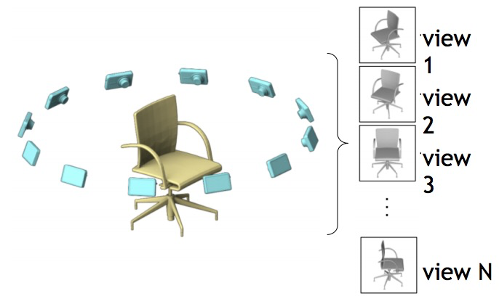
Multi-view RGB(D) images
7
Notes:
A combination of multiview 2D images for the same object from different point of views
Representing the 3D object with an insufficiently small number of views might not capture the properties of the whole 3D shape and might cause an over-fitting problem. In addition, too many views cause an unneeded computational overhead.
https://www.cv-foundation.org/openaccess/content_iccv_2015/papers/Su_Multi-View_Convolutional_Neural_ICCV_2015_paper.pdf

Slide 7
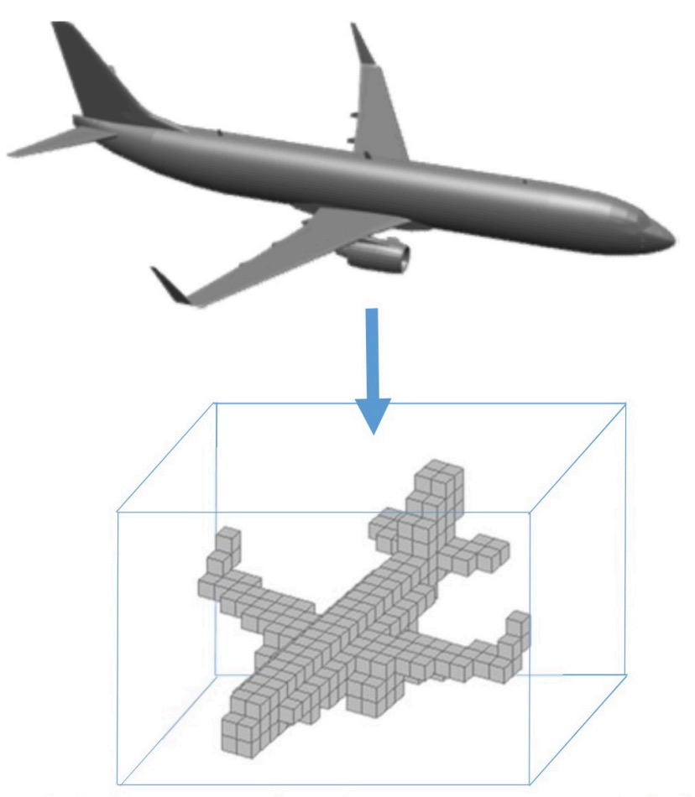
Volumetric
Notes:
Based on a regular grid in the three dimensional space.
ShapeNet [13] is the first DL model exploiting the geometry of 3D objects represented as voxels. The input object is represented as a 30x30x30 binary tensor indicating whether the voxel is part of the 3D object or not.
https://pdfs.semanticscholar.org/b2ec/9d0c9fadba4174e1ae5d29fccb7b344dc365.pdf

Slide 8
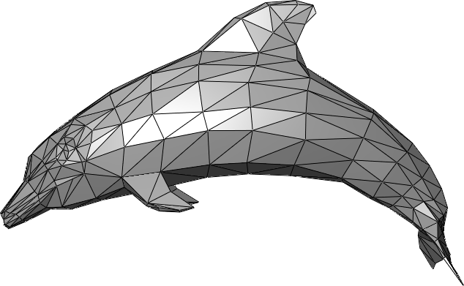
Polygonal mesh
Notes:
A 3D mesh structure consists of a set of polygons called faces described in terms of a set of vertices that describe how the mesh coordinates exist in the 3D space.
These vertices are associated with a connectivity list which describes how these vertices are connected to each other
The local geometry of the meshes can be realized as a subset of a Euclidean space following the grid-structured data. However, on a global aspect, meshes are non-Euclidean data where the familiar properties of the Euclidean space are not well defined such as shift-invariance, operations of the vector space and the global parametrization system.

Slide 9
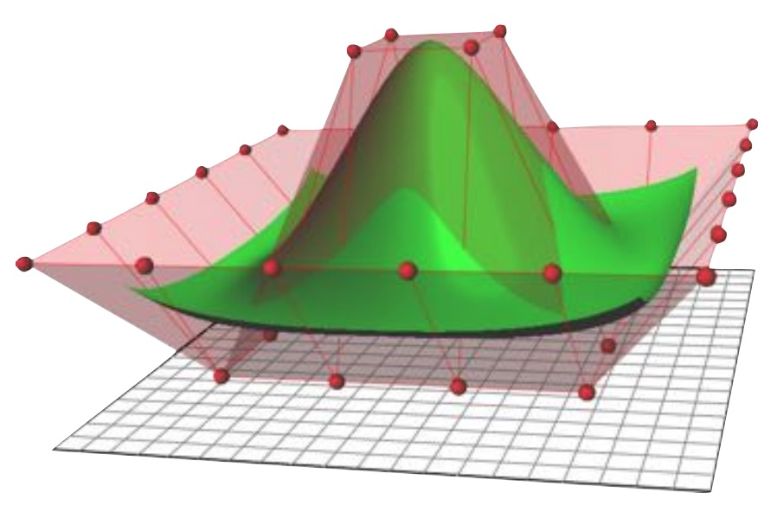
Primitive-based CAD models
Notes:
made of a number of primitives(represent basic shapes like box, cone, and cylinder), each might also have its own control points and other kind of parametric representation.
Primitives are limited versions of part models that are designed for repeated use in part creation. They represent basic shapes, such as a box or a torus, and commonly used connections on parts
Primitives include the following modeling features:
work planes
geometry, constraints, dimensions, and model parameters
profiles (2D outlines of geometric shapes)
modifiers (operations that create 3D features from profiles)
https://knowledge.autodesk.com/support/autocad-mep/learn-explore/caas/CloudHelp/cloudhelp/2019/ENU/AutoCAD-MEP/files/GUID-32257F22-76D2-44F6-98A4-C96356AC41D2-htm.html

Slide 10
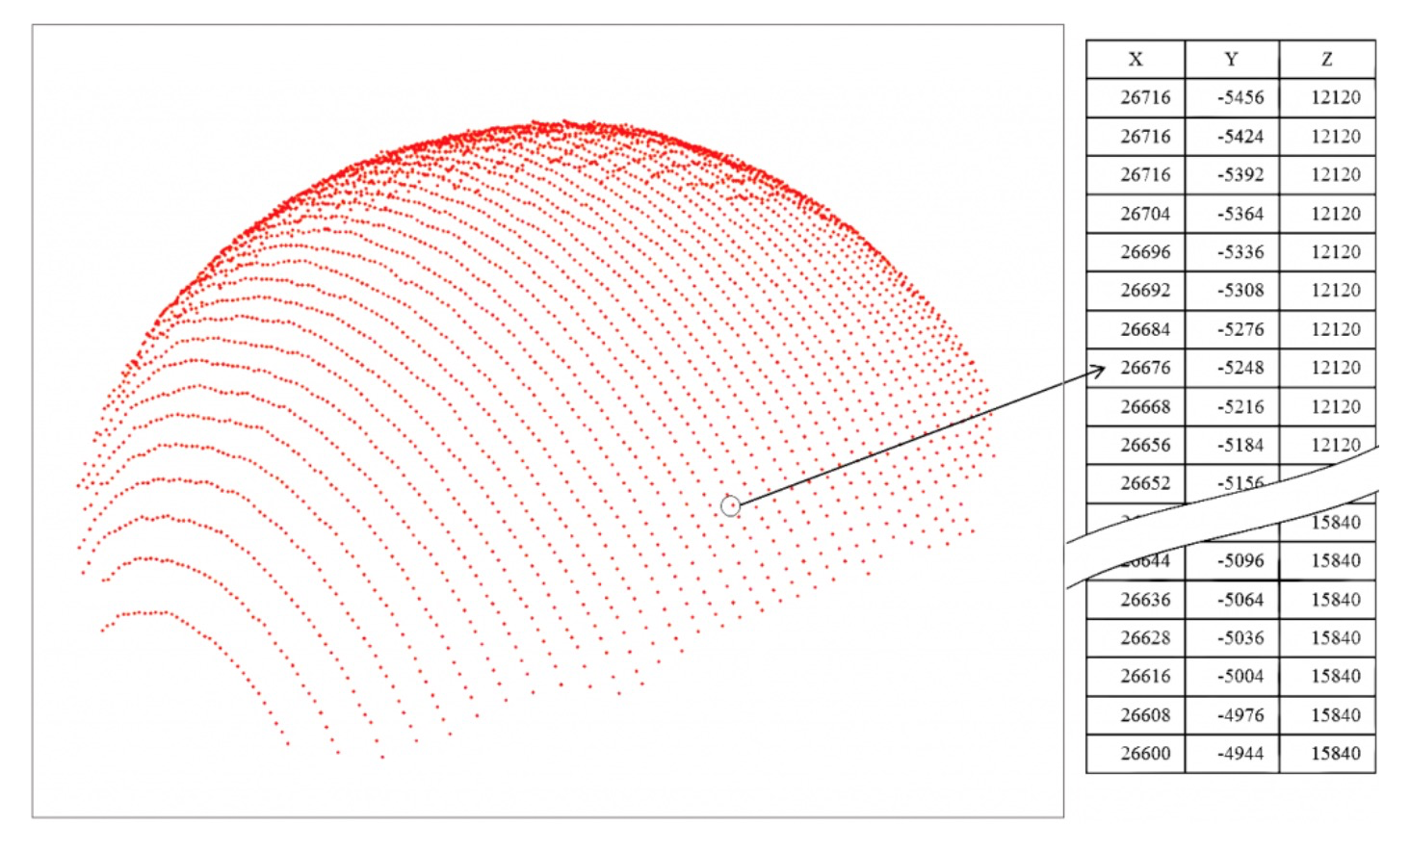
Point Cloud
Notes:
a set of unstructured 3D points that represent the geometry of 3D objects
need to be invariant to transformations such as translation and rotation.
lack of connectivity information in the point clouds
the raw captured point clouds suffer from noise, incompleteness, irregular sampling density and sometimes holes and missing parts.

Slide 11
3D representation
Euclidean-structured data
Multi-view RGB(D) images
Volumetric
Non-Euclidean data
Polygonal mesh
Primitive-based CAD models
Point cloud
Notes:
Some 3D data representations have an underlying Euclidean-structure where the properties of the grid structured data are preserved such as having a global parametrization and a common system of coordinates
Non-Euclidean data suffers from the absence of the global parametrization and the non-existence of a common system of coordinates or vector space structure
even if this data looks like Euclidean locally, in practice, they suffer from infinite curvature, self-intersections and different dimensions depending on the scale and location at which one looks

Slide 12
Content
Point Cloud
Representation issue of 3D deep learning
Why we use point cloud
Comparison of point cloud data
Point cloud generation by deep learning
PointOutNet
Learning free-form deformations for 3D reconstruction (short as FFD)
3D classification and segmentation using Point sets
PointNet
Summary
Reference

Slide 13
Why we use point cloud
Simplest representation
unorder
no connectivity information
only encoding the surface points
Flexible
a few thousands of points can precisely model a great variety of shapes
Deformable, interpolable, extrapolable
Notes:
deformation approach based on point clouds [1], which eliminates the necessity to maintain the consistency of mesh topology information, and avoid complex mesh regeneration operations

Slide 14
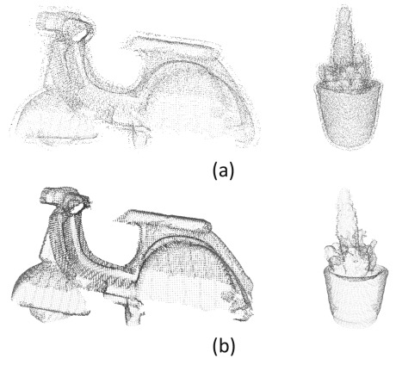
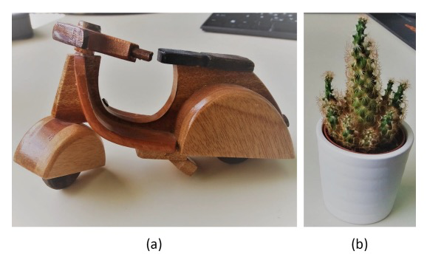
Severe limitations of point cloud
No subdivision
No direct smooth rendering
No topological information
Suffer from noise, outlier, irregular sampling density and sometimes missing parts
Notes:
subdivision: smoother curve or surface

Slide 15
Content
Point Cloud
Representation issue of 3D deep learning
Why we use point cloud
Comparison of point cloud data
Point cloud generation by deep learning
PointOutNet
Learning free-form deformations for 3D reconstruction (short as FFD)
3D classification and segmentation using Point sets
PointNet
Summary
Reference

Slide 16
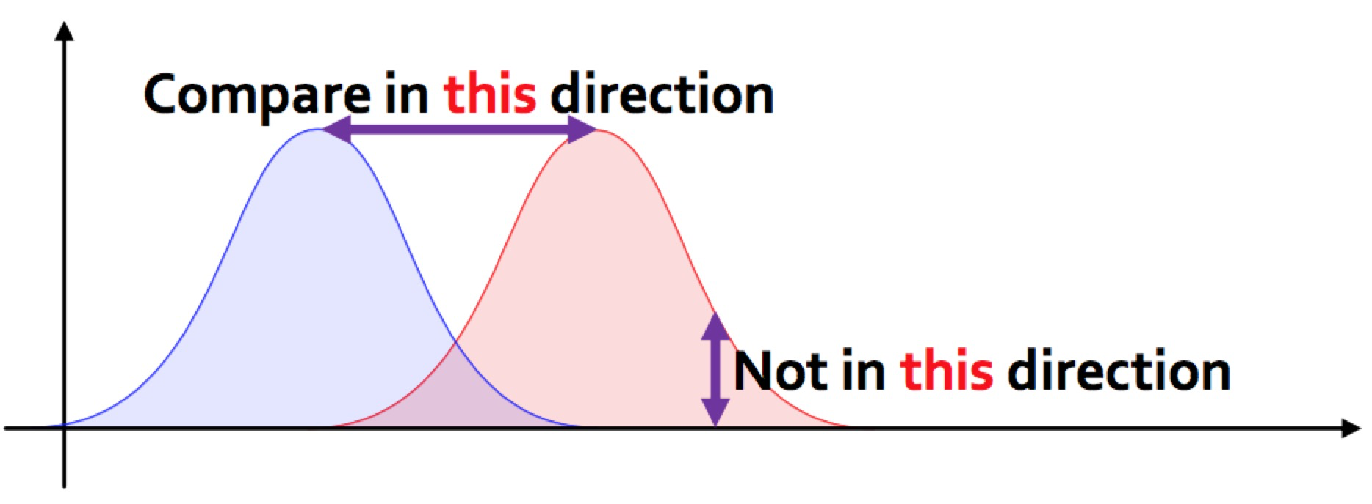
Comparison of point cloud data
To measure uncertainty, we represent point cloud as a probability distribution.
Compare point cloud is to compare underlying distributions.
We need a new measurement.

Slide 17
Comparison of point cloud data
Properties we need for the metrics
geometric requirements
computational requirements
Earth Mover’s distance (EMD)
Chamfer distance (CD)

Slide 18
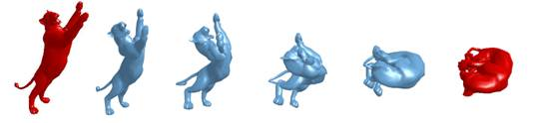
Geometric requirements
Reflects natural shape differences.
Induce a nice space for shape interpolations.

Slide 19
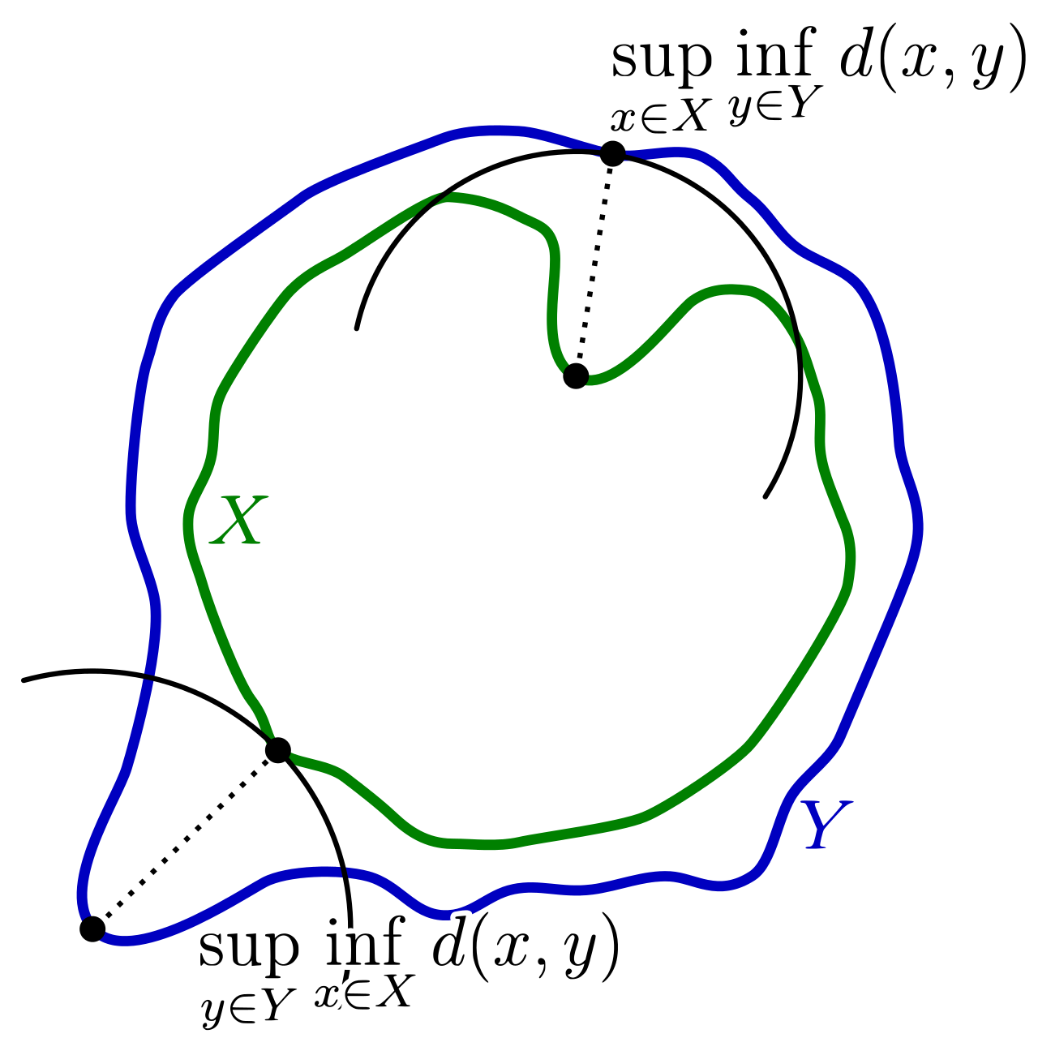
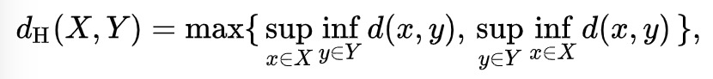
Computational requirement
Define a good loss function
Differentiable with respect to point locations
Efficient to compute, as data will be forwarded and back-propagated for many times
Robust against small number of outlier points
e.g. Hausdorff distance would fail

Slide 20
Comparison of point cloud data
Properties we need for the metrics
geometric requirements
computational requirements
Earth Mover’s distance (EMD)
Chamfer distance (CD)

Slide 21
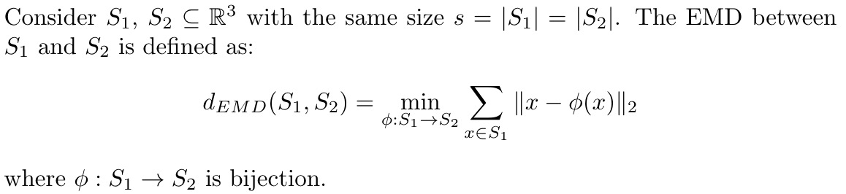
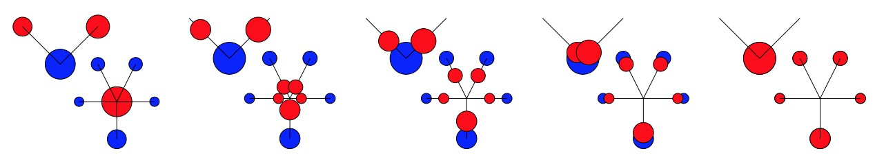
Earth Mover’s distance (EMD)
The Earth Mover’s Distance between two distributions is the minimum amount of work required to change one distribution into the other.
Notes:
http://infolab.stanford.edu/pub/cstr/reports/cs/tr/99/1620/CS-TR-99-1620.ch4.pdf

Slide 22
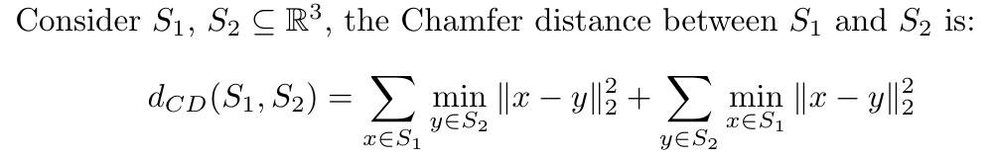
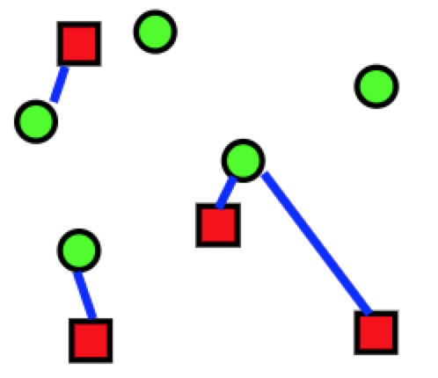
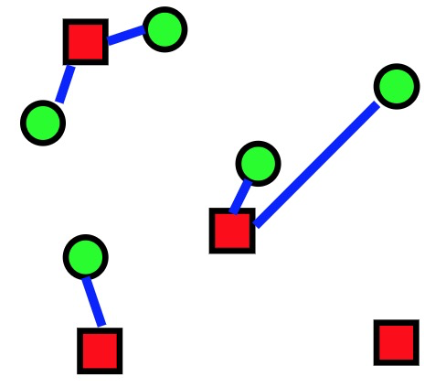
Chamfer distance (CD)
Average matching distance to nearest feature.
Sum of average distance from each red point to the nearest green point and average distance from each green point to the nearest red point.
Notes:
https://slideplayer.com/slide/3315099/

Slide 23
Content
Point Cloud
Representation issue of 3D deep learning
Why we use point cloud
Comparison of point cloud data
Point cloud generation by deep learning
PointOutNet
Learning free-form deformations for 3D reconstruction (short as FFD)
3D classification and segmentation using Point sets
PointNet
Summary
Reference

Slide 24
3D object reconstruction (Literature review)
3D reconstruction from single images
[1] J. Fuentes-Pacheco, J. Ruiz-Ascencio, and J. M. Rendon-Mancha. Visual simultaneous localization ´ and mapping: a survey. Artificial Intelligence Review, 43(1):55–81, 2015.
[2] B. K. Horn. Obtaining shape from shading information. In Shape from shading, pages 123–171. MIT
press, 1989.
[3] Q. Huang, H. Wang, and V. Koltun. Single-view reconstruction via joint analysis of image and shape
collections. ACM Transactions on Graphics (TOG), 34(4):87, 2015.
[4] C. B. Choy, D. Xu, J. Gwak, K. Chen, and S. Savarese. 3d-r2n2: A unified approach for single and multiview 3d object reconstruction. arXiv preprint arXiv:1604.00449, 2016
Hao Su et al.
Deep learning for geometric object synthesis
In general, the field of how to predict geometries in an end-to-end fashion is quite a new area.

Slide 25
PointOutNet: Problem setting
On the task of 3D reconstruction from a single image, the point set generation network is applied which significantly outperform state of the art
Issues in the architecture and loss function design for point generation network is systematically explored
A principled formulation and solution to address the groundtruth ambiguity issue for the 3D reconstruction from single image task is proposed.

Slide 26
PointOutNet: Three subproblem
Point set generator architecture
Loss function for point set comparison
Modeling the uncertainty of groundtruth

Slide 27
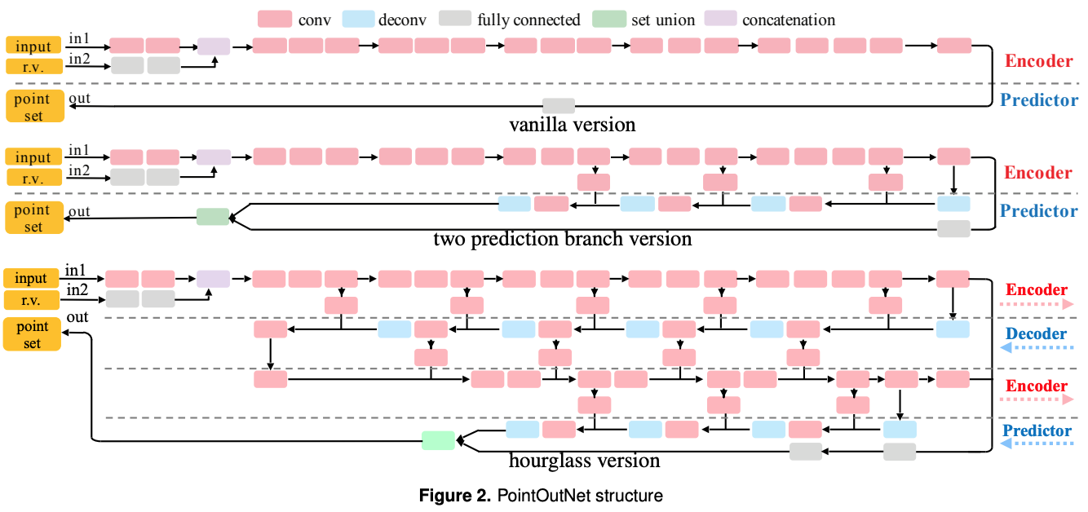
PointOutNet: approach

Slide 28
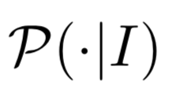
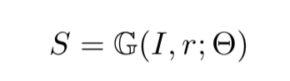
Loss Function for Point Sets
Point set is defined as S = {(xi, yi, zi)}, i=1:N.
1) differentiable with respect to point locations;
2) Efficient to compute, as data will be forwarded and back-propagated for many times;
3) Robust against small number of outlier points in the sets.

Slide 29
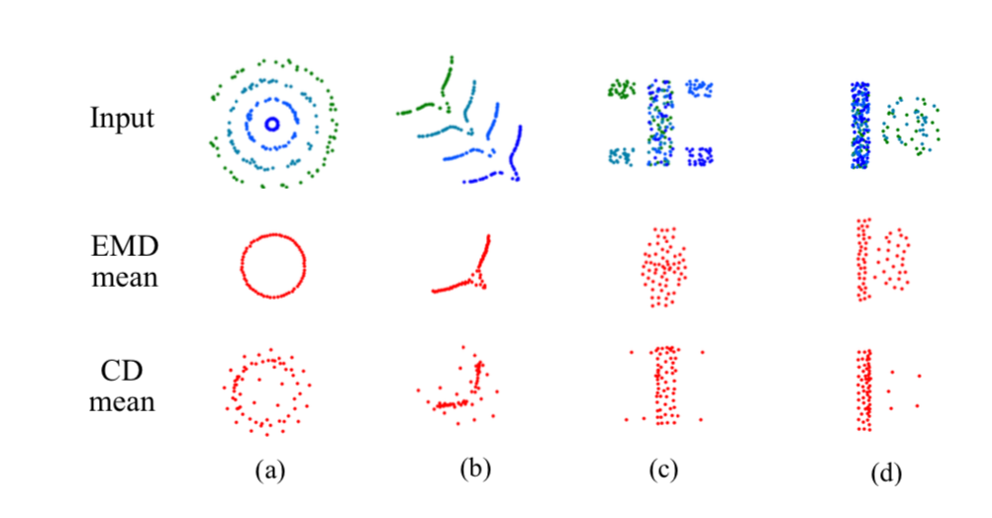
Shape Space
Neural networks inevitably encounter uncertainty in predicting the precise geometry of an object.
Mean-shape behavior of EMD and CD on synthetic shape distributions, by minimizing Es∼S[L(x, s)].

Slide 30
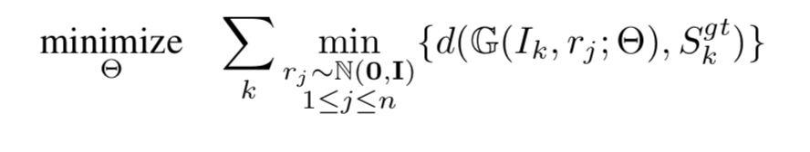
Generation of Multiple Plausible Shapes
Ambiguity of the prediction arises at test time, the depth for visible parts is under-determined, and the geometry for invisible parts has to be hallucinated by guessing.
Min-of-N Loss (MoN):

Slide 31
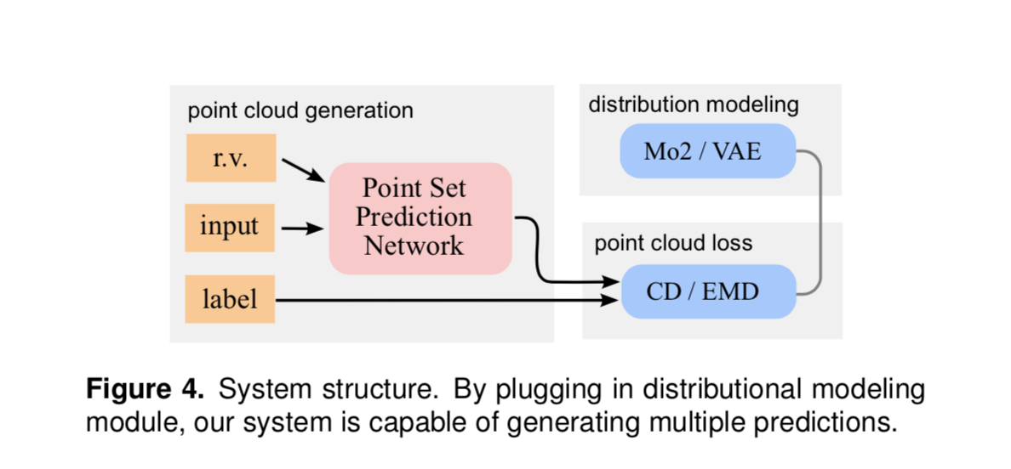
Generation of Multiple Plausible Shapes
Min-of-N Loss (MoN)

Slide 32
Generation of Multiple Plausible Shapes
Dataset and description:
The ShapeNet dataset (containing large volume of manually cleaned 3D object models with texture)
We compare Hao Su et. al.’s work with 3D-R2N2 [5]
To enable the comparison, we re-trained our networks on the dataset used by 3D-R2N2’s authors. The results are compared under three different metrics CD, EMD and IoU (intersection over union).
[5] C.B.Choy,D.Xu,J.Gwak,K.Chen,andS.Savarese. 3d-r2n2: A unified approach for single and multi- view 3d object reconstruction. arXiv preprint arXiv:1604.00449, 2016.

Slide 33
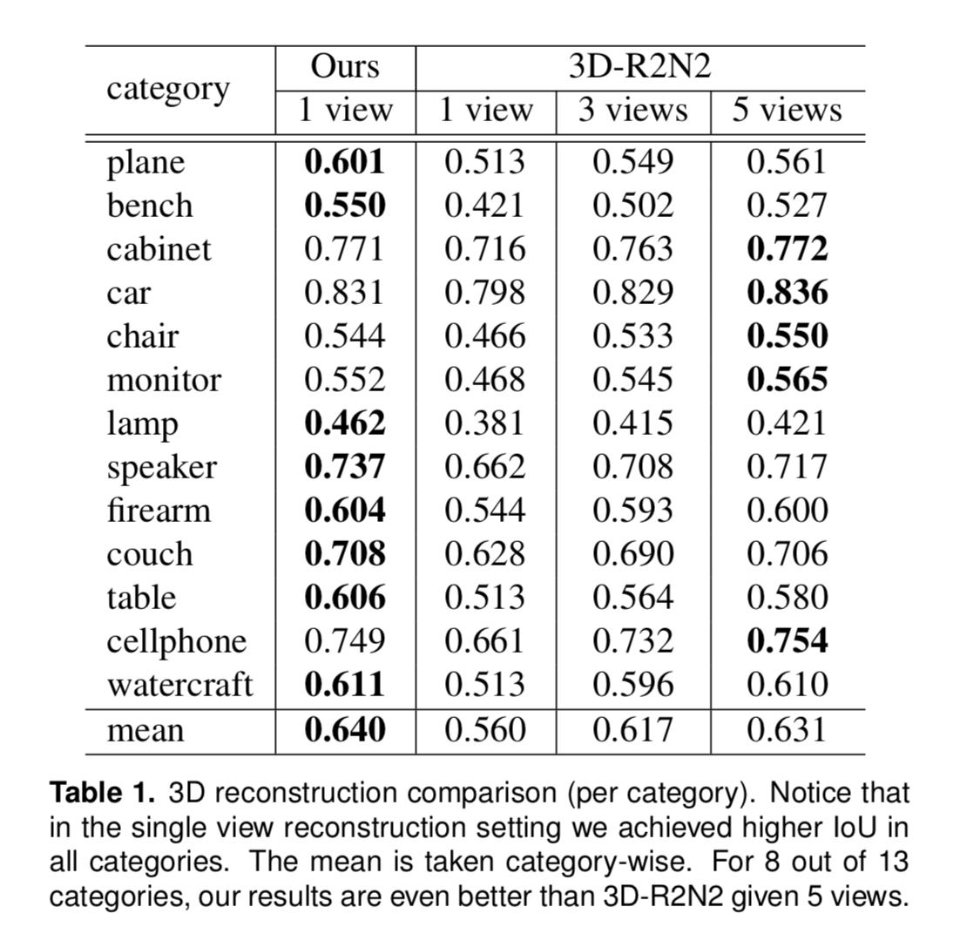
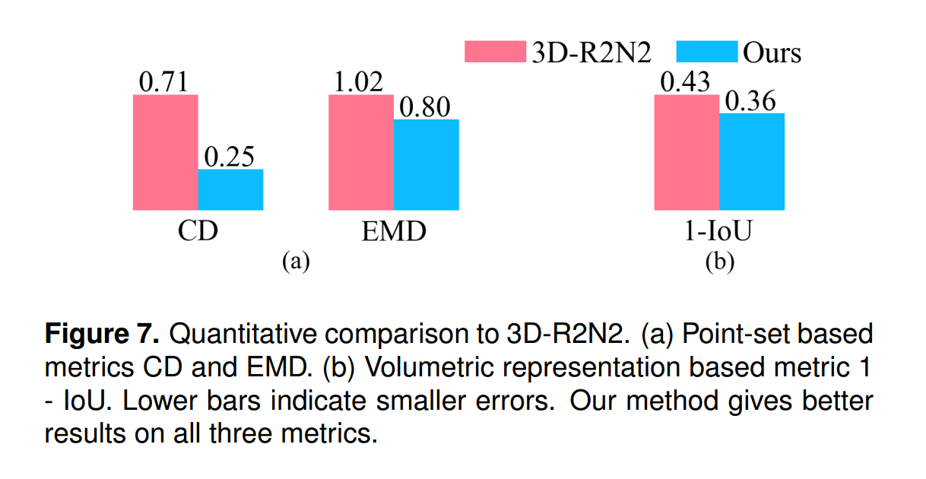
PointOutNet: Experiments
3D Shape Reconstruction from RGB Images

Slide 34
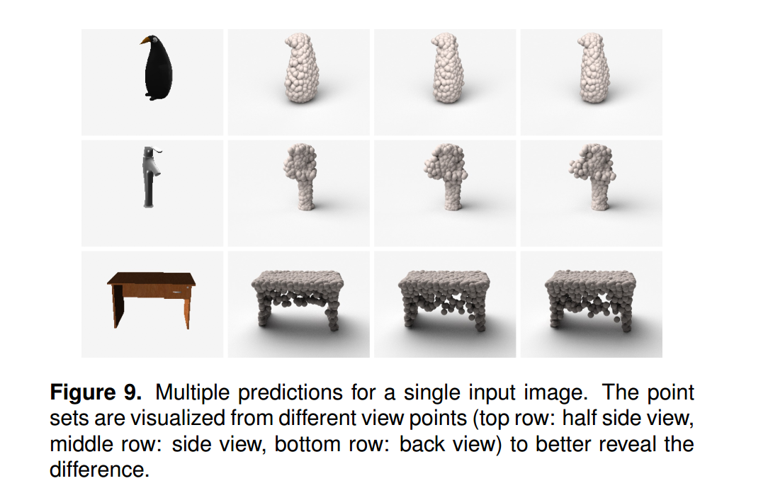
PointOutNet: Experiments
Predicting Missing part

Slide 35
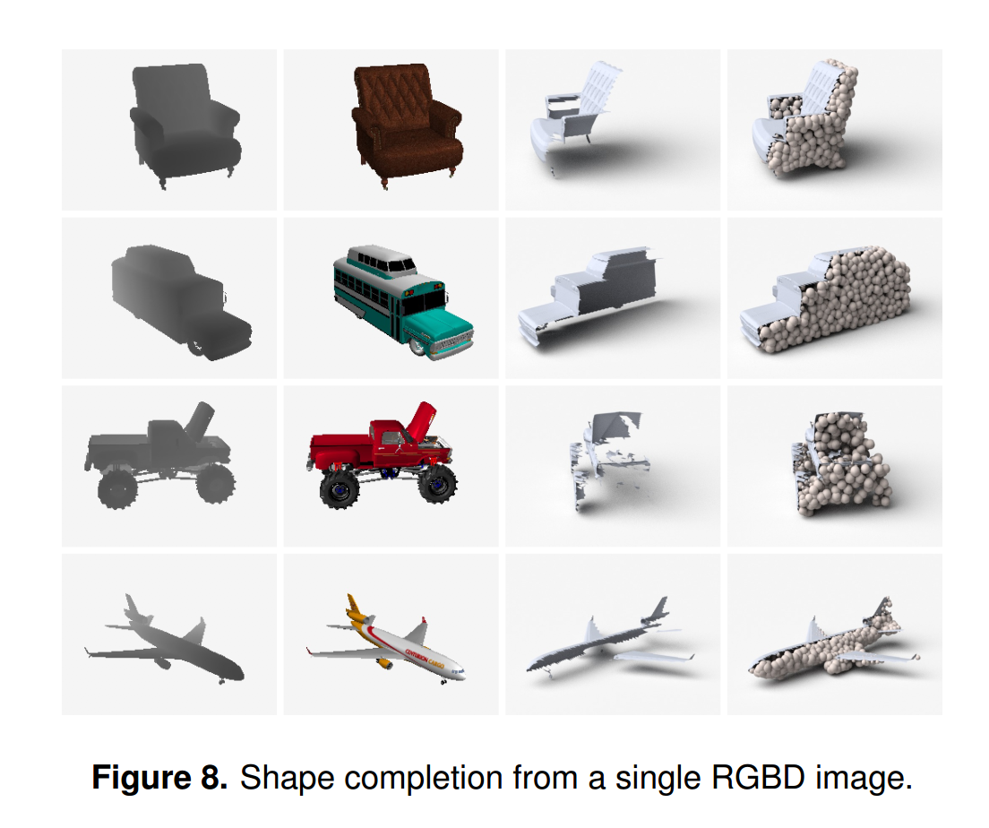
PointOutNet: Experiments
3D Shape Completion from RGBD Images

Slide 36
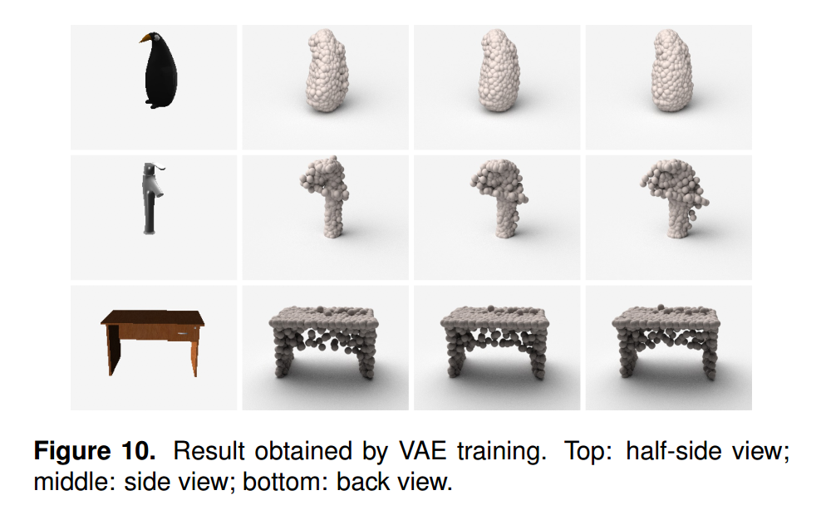
PointOutNet: Experiments
Predicting Multiple Plausible Shapes

Slide 37
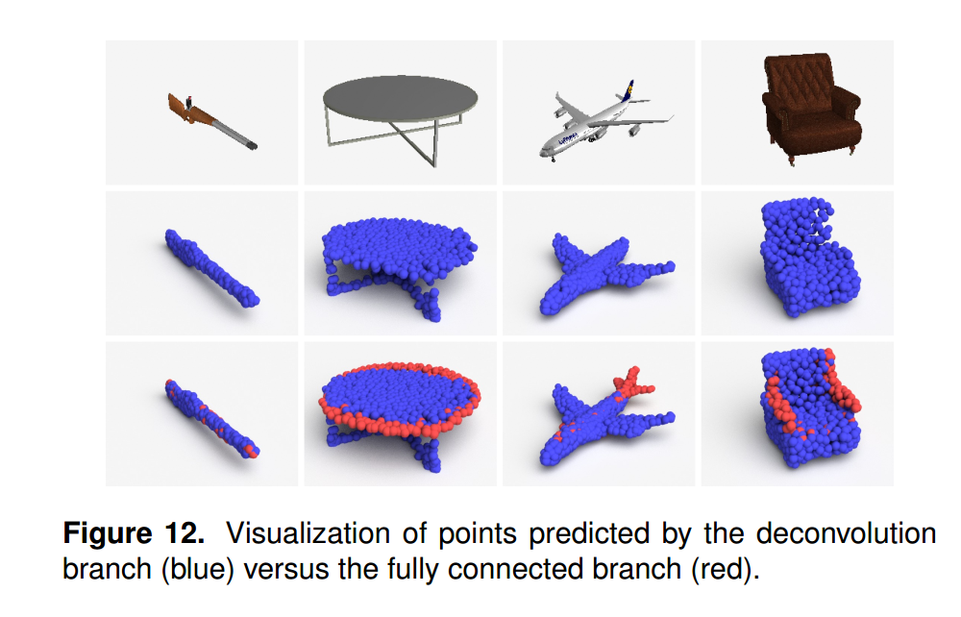
PointOutNet: Experiments
Effect of combining deconv and fc branches for reconstruction

Slide 38
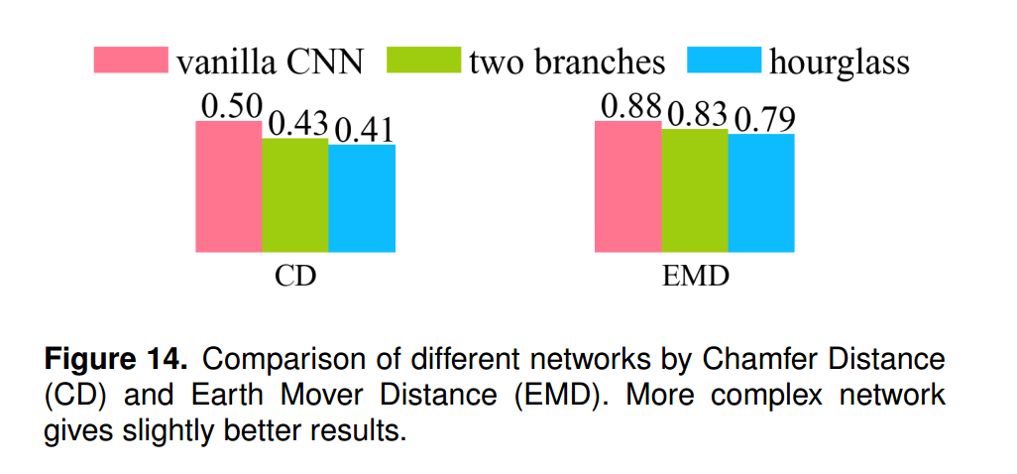
PointOutNet: Experiments
Effect of combining deconv and fc branches for reconstruction

Slide 39
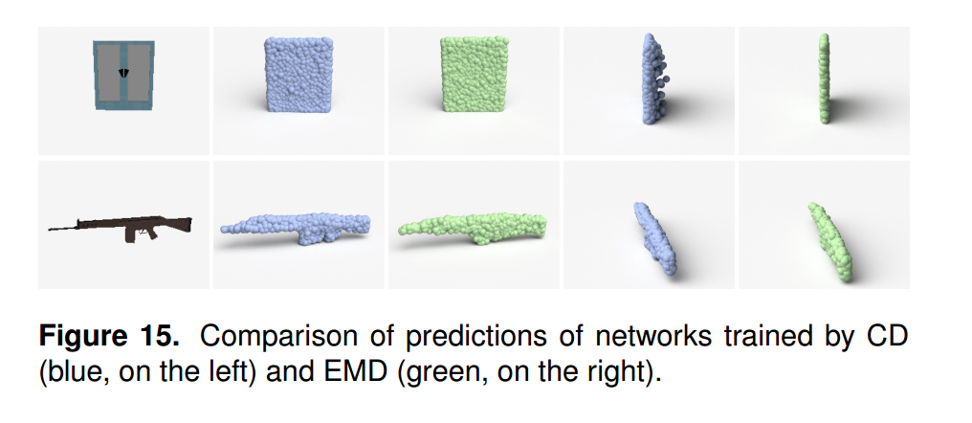
PointOutNet: Experiments
Analysis of distance metrics: CD vs EMD

Slide 40
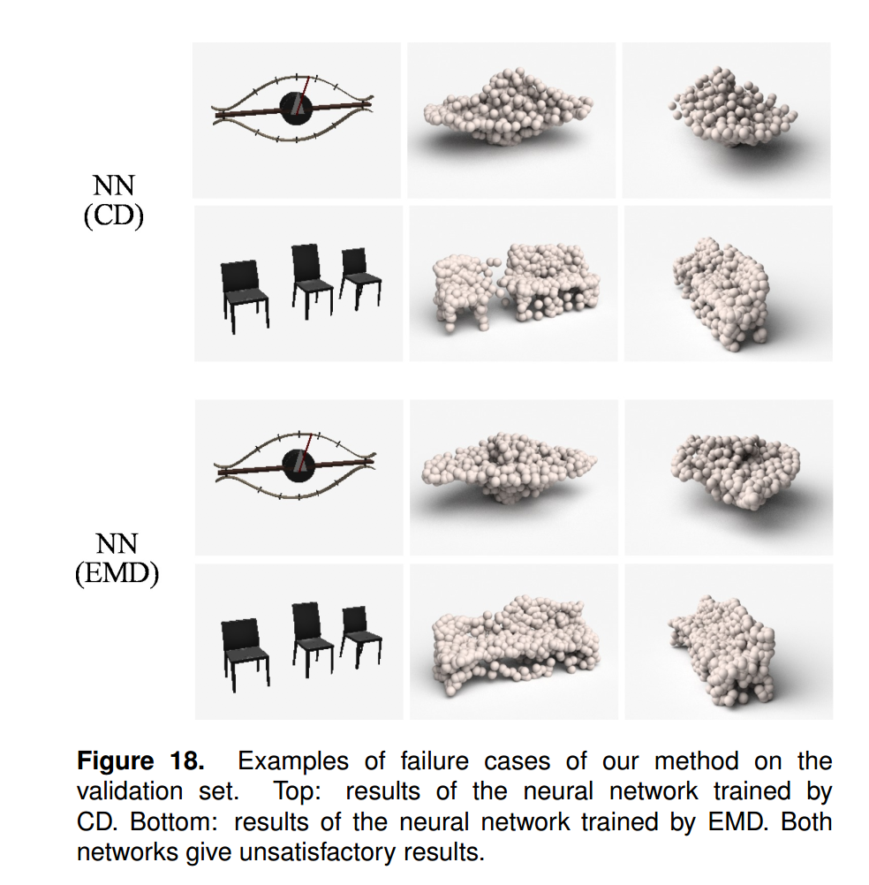
PointOutNet: Experiments
Analysis of failure cases

Slide 41
Content
Point Cloud
Representation issue of 3D deep learning
Why we use point cloud
Comparison of point cloud data
Point cloud generation by deep learning
PointOutNet
Learning free-form deformations for 3D reconstruction (short as FFD)
3D classification and segmentation using Point sets
PointNet
Summary
Reference

Slide 42
Learning Free-Form Deformations for 3D Object Reconstruction
Dominic Jack, Jhony K. Pontes, Sridha Sridharan, Clinton Fookes,
Sareh Shirazi, Frederic Maire, Anders Eriksson
Queensland University of Technology, Brisbane, Australia
29 Mar 2018

Slide 43
Learning FFD: problem setting
Voxel representation:
Grows cubically in terms of memory and computational complexity as the voxel grid resolution increases
limited to low-quality 3D reconstructions.
3D-R2N2： Choy, C.B., Xu, D., Gwak, J., Chen, K., Savarese, S. 2016
Perspective transformer net: Yan, X., Yang, J., Yumer, E., Guo, Y., Lee, H. 2016
…...

Slide 44
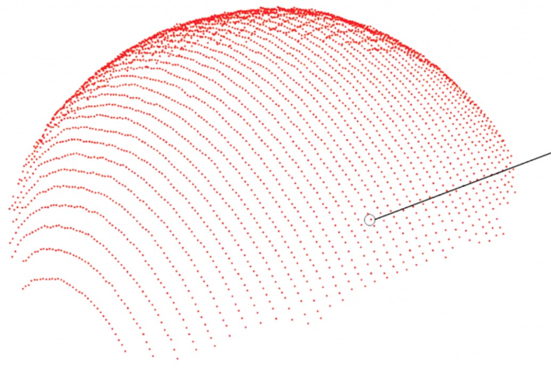
Learning FFD: problem setting
Point cloud：
More efficient
Lack of topological information
Applying surfaces, texture, and lighting to point clouds are also challenging
Point Cloud Generation: Fan, H., Su, H., Guibas, L.J, 2018
PointNet and PointNet++: Qi, C.R., Su, H., Mo, K., Guibas, L.J.: PointNet 2017
…...

Slide 45
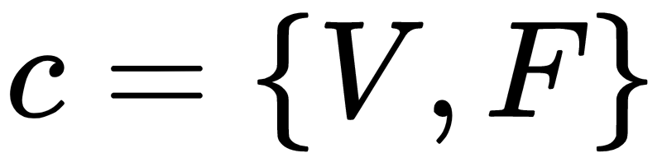
Learning FFD: problem setting
Polygon meshes -- triangular faces
Represent a 3D mesh as
In this paper:
Designed a method to reconstructure high quality 3D meshes efficiently by learning FFD
DeformNet: Kurenkov, A., Ji, J., Garg, A., Mehta, V., Gwak, J., Choy, C.B., Savarese, S. 2017
…...

Slide 46
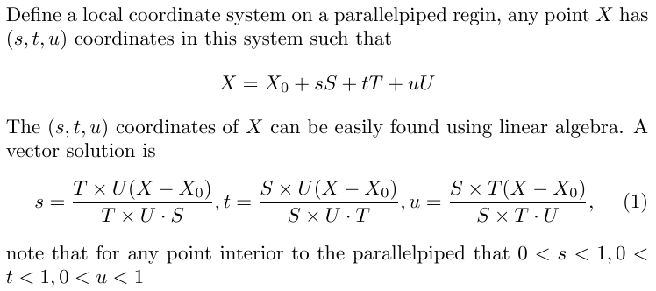
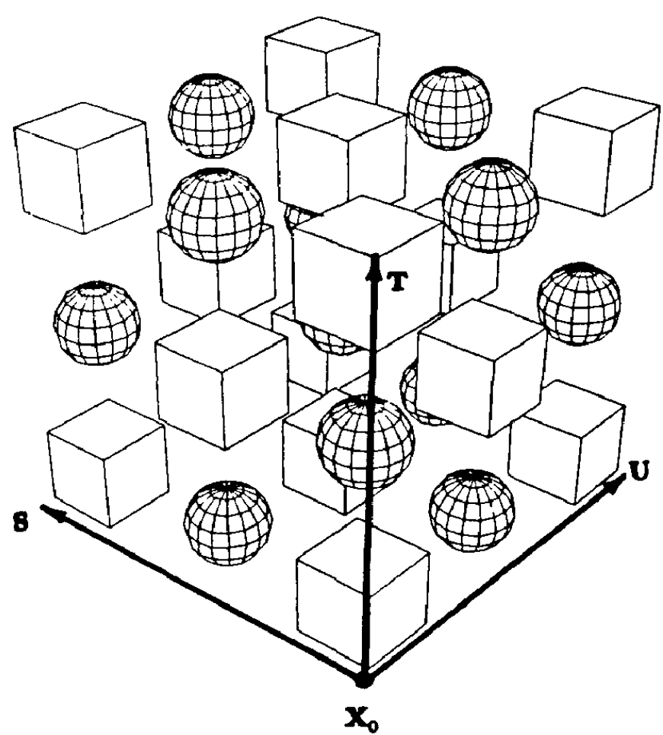
Learning FFD: Free-Form Deformation
Free-form deformation of solid geometric models. Thomas W. Sederberg Scott R. Parry t 1986
Notes:
FFD has be explored for 3D mesh representation where one can intrinsically represent an object by a set of polynomial basis functions and a small number of coefficients known as control points used for cage-like deformation

Slide 47
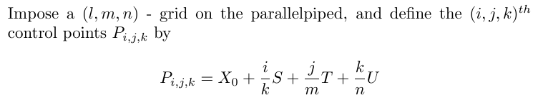
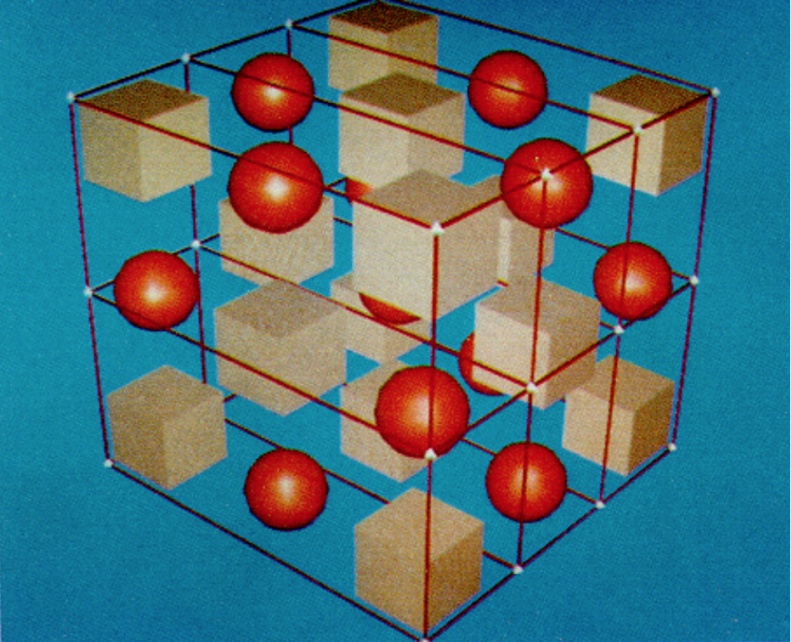
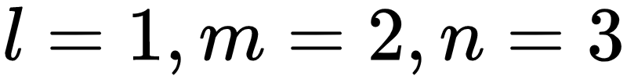
Learning FFD: Free-Form Deformation

Slide 48
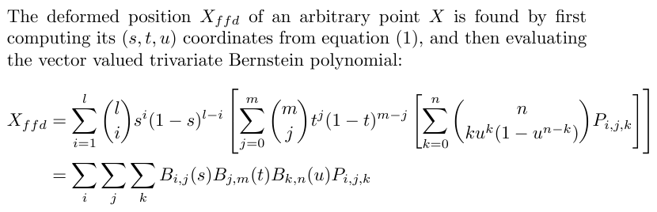
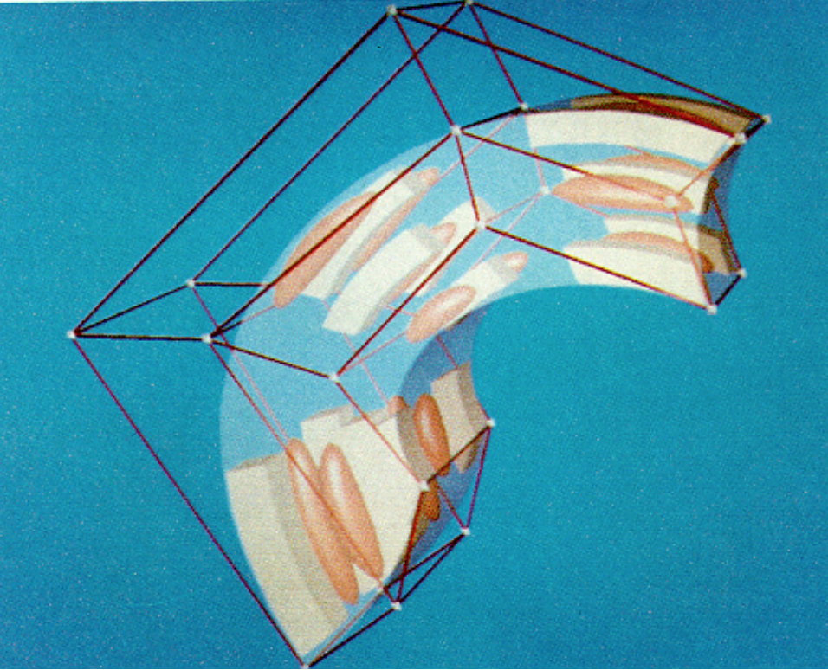
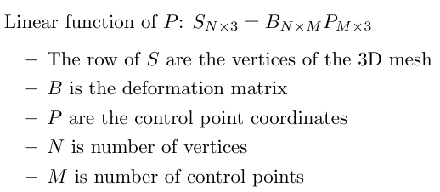
Learning FFD: Free-Form Deformation

Slide 49
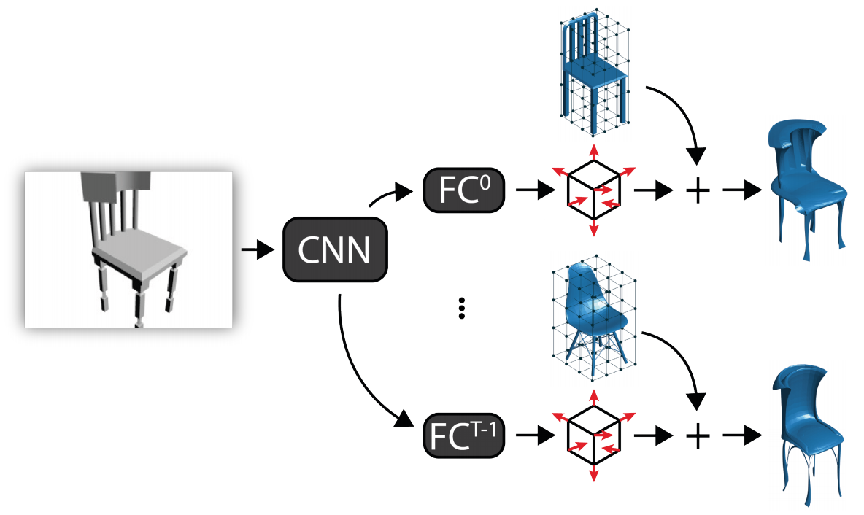
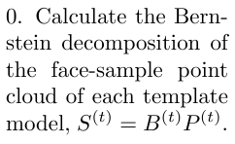
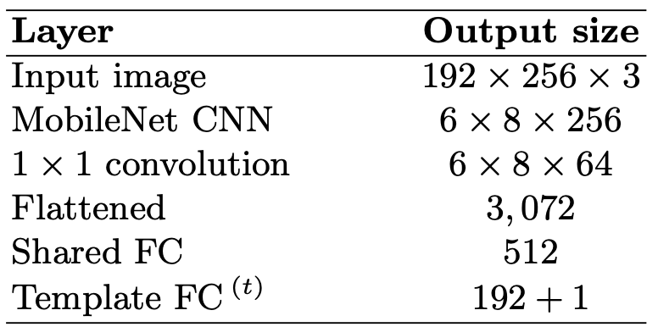
Learning FFD: approach
We Choose T template for the model
Notes:
At the begging, calculate the Bernstain decomposition of the face-sample point cloud of each template model

Slide 50
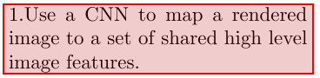
Learning FFD: approach
Notes:
Then we employed a MobileNet architecture that uses depthwise separable convolutions to build light weight deep NN without the final FC layers. Weights were initialized from the convolutional layers of a network trained on the 192 by 192 ImageNet dataset.
To reduce dimensionality we add a single 1 by 1 convolutional after the final MobileNet convolution layer

Slide 51
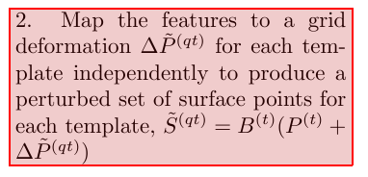
Learning FFD: approach
Notes:
After flattened the result, we have on shared FC layer with 512 nodes followed by a FC
layer for each template (sub-nets)

Slide 52
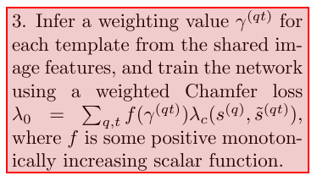
Learning FFD: approach
Notes:
For loss function, we choose weighted Chamfer loss

Slide 53
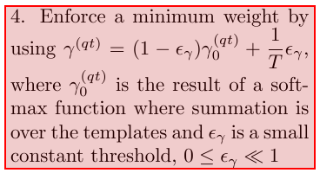
Learning FFD: approach
Notes:
gamma zero qt is produced by each FC model

Slide 54
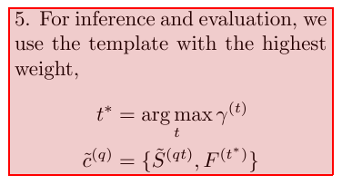
Learning FFD: approach
Notes:
FFD has be explored for 3D mesh representation where one can intrinsically represent an object by a set of polynomial basis functions and a small number of coefficients known as control points used for cage-like deformation

Slide 55
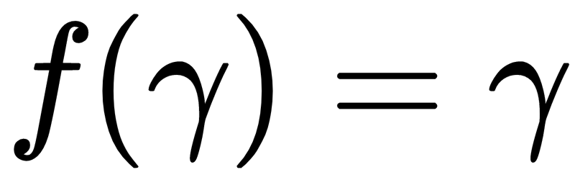
Learning FFD: approach
Diversity in Model Selection
Base model:
a small number of templates being selected frequently
If a particular template deformation sub-network performs particularly well initially, the weighting sub-network learns to assign increased weight to this template.

Slide 56


Learning FFD: approach
Diversity in Model Selection:
Non-linear Weighting:
discourage the netfork from making overly confident inference.

Slide 57


Learning FFD: approach
Diversity in Model Selection
Explicit Entropy Penalty:
large entropy error term encourages all templates to be assigned weight
Force all sub-net to try and learn all possible deformations.
Against the idea of specialization: each sub-net should learn to deform their template to match query models close to their template
Aneal the entropy over the time to alleviate this

Slide 58


Learning FFD: approach
Deformation Regularization
Large regularization encourages a network to select the closest matching template
Punish sub-net for deforming their template a lot
Kappa is an exponentially annealed weighting with initial value

Slide 59

Learning FFD: Experiment result
Subset of ShapeNet Core dataset
4 control points in each dimension (l = m = n = 3)
We trained a different network with 30 templates for each category
Templates were selected manually to ensure good variety

Slide 60

Learning FFD: Experiment result

Slide 61

Learning FFD: Experiment result

Slide 62

Learning FFD: Experiment result

Slide 63
Content
Point Cloud
Representation issue of 3D deep learning
Why we use point cloud
Comparison of point cloud data
Point cloud generation by deep learning
PointOutNet
Learning free-form deformations for 3D reconstruction (short as FFD)
3D classification and segmentation using Point sets
PointNet
Summary
Reference

Slide 64
PointNets: Deep Learning on Point Sets for 3D Classification and Segmentation
Charles R. Qi, Hao Su, Kaichun Mo, Leonidas J. Guibas
Stanford University
10 Apr 2017

Slide 65
PointNet: problem setting
Most researchers typically transform point cloud data to regular 3D voxel grids before feeding them to a net
Resulting data unnecessarily voluminous
Introduce quantization artifacts that can obscure natural invariances of the data.
Question:
Can we achieve effective feature learning directly on point cloud?

Slide 66

PointNet:
Unified framework on Point Cloud for various task

Slide 67
PointNet: challenges
Unordered point set as input:
Model needs to be invariant to permutations
Model also need to be invariant to geometrical rigid motions

Slide 68

PointNet: challenges (invariant to permutations)
Point Cloud:
N orderless points
Each represented by an D-dimensional feature vector, including:
Position (x, y, z)
Other features: color, normal etc (optional)
image from http://cseweb.ucsd.edu/~haosu/

Slide 69

PointNet: challenges (invariant to permutations)
invariant to permutation: symmetric function
Notes:
NN is a function, a NN that is invariant to permutations corresponding to symmetric functions。In symmetric function, for arbitrary order of the same argument, the function value should keep the same.
max operation, summation,

Slide 70

PointNet: challenges (invariant to permutations)
How can we build a family of symmetric function by neural networks?
invariant to permutation: symmetric function
image from http://cseweb.ucsd.edu/~haosu/
Notes:
First, we can transform each point independently and identically by a small multi-layer perceptron network h, project row point into high-dimentional embedding space
Then we aggregate the embedded point features by a simple symmetric function into a single global feature
in the last, we post transform the the aggregated information by another FC network gamma
Call this pointnet vanilla
guarantee to be invantant of order of input argument。
Question：Amoung the space of all symmetric functions, what function can be constructed/ approximated by pointNet

Slide 71

PointNet: Theoretical Analysis
Universal approximation
Notes:
This question leads to theoritic analysis of pointNet,
The authors showed that any symmetric function that is continuous w.r.t to Hausdorff distance can be arbitrarily approximated by pointNet

Slide 72

PointNet: challenges
Unordered point set as input:
Model needs to be invariant to permutations
Point cloud rotations should not alter the classification result
image from http://cseweb.ucsd.edu/~haosu/
Notes:
Another challenge
The labeling of a point cloud has to be invariant if the point cloud undergoes certain geometric transformations, such as rigid transformation. We therefore expect that the learnt representation by our point set is invariant to these transformations.

Slide 73

PointNet: challenges(invariant to rigid motions)
Align input point cloud to a canonical space
Inspired by Jaderberg et al. [9] spatial transformer to align 2D images (2015)
image from https://www.youtube.com/watch?v=Cge-hot0Oc0
Notes:
A natural solution is to align all input set to a canonical space before feature extraction.
Jaderberg et al. [9] introduces the idea of spatial transformer to align 2D images through sampling and interpolation, achieved by a specifically tailored layer implemented on GPU.
Out input is point cloud, much simpler, the geometric transformation is just matrix multiplication, we do not need to invent any new layers and no alias is introduced as in the image case. We can easily achieve the alignment by applying an affine transformation to the input point cloud coordinates
We predict the affine transformation matrix by a mini-network (T-net end-to-end trained with the rest of the network) and directly apply this transformation to the coordinates of input points

Slide 74



PointNet: approach
Notes:
Extended the transformation matrix idea to the feature space.
Dimension of the Transformation matrix A is much higher ---- increased the difficulty of training.
To avoid our training stop at bad local minimum, we introduced a regularization term into the softmax loss, to constrain the feature space transformation matrix to close to orthogonal matrix.
The max pooling over-performed in experiment v.s. average pooling, weighted average pooling

Slide 75
PointNet: approach
Notes:
For Segmentation Network: Noticing that point segmentation requires a combination of local and global knowledge.
After computing the global point cloud feature vector, we feed it back to per point features by concatenating the global feature with each of the point features. Then we extract new per point features based on the combined point features - this time the per point feature is aware of both the local and global information.

Slide 76

PointNet: Experiment result
3D Object Classification
Notes:
Classification evaluate on ModelNet40: 40-class classification dataset
We uniformly sample 1024 points on mesh faces according to face area and normalize them into a unit sphere.
PointNet as the first DL NN on point cloud already achieved start-of-art models in 3D classification tasks

Slide 77


PointNet: Experiment result
3D Object Part Segmentation
Notes:
results on object part segmentation on ShapeNet part data set which contains 16,881 shapes from 16 categories, annotated with 50 parts in total.
We formulate part segmentation as a per-point classification problem.
on both partial inputs and complete input
mean Intersection over Union on points

Slide 78

PointNet: Time and Space Complexity
image from http://cseweb.ucsd.edu/~haosu/
Notes:
The “M” stands for million

Slide 79

PointNet: Time and Space Complexity
image from http://cseweb.ucsd.edu/~haosu/
Notes:
FLOP stands for floating-point operation.

Slide 80

PointNet: Robustness
Notes:
Random drop points and see how accuracy suffers. Even after dropping 50% of the points, accuracy drops only by 2%
Also robust to outlier, evaluate two model: one trained on points with xyz coordinates, the other on xyz plus point density. The net has more than 80% accuracy even when 20% of the points are outliers.
Third Gaussian noise to each point independently
Why robust: what has been learned in global feature, some of the point won’t contribute, the point that contrubute:critical point set

Slide 81

PointNet: Robustness
Notes:
Why robust: what has been learned in global feature, some of the point won’t contribute to the global feature because of the max pooling,
We call the subset of the point that contributed as critical point set, summarizes the skeleton of the shape
The upper-bound set illustrates the largest possible point cloud that give the same global shape feature f(S) as the input point cloud S but not contribute to the global feature
losing some non-critical points does not change the global shape signature f(S) at all

Slide 82
Content
Point Cloud
Representation issue of 3D deep learning
Why we use point cloud
Comparison of point cloud data
Point cloud generation by deep learning
PointOutNet
Learning free-form deformations for 3D reconstruction (short as FFD)
3D classification and segmentation using Point sets
PointNet
Summary
Reference

Slide 83
Summary
PointOutNet:
Some fundamental problems are addressed: First, how to generate an orderless set of entities. Towards building generative models for more sophisticated combinatorial data structures such as graphs, knowing how to generate a set may be a good starting point.
Second, how to capture the ambiguity of the groundtruth in a regression problem.
Learning Free-Form Deformation:
Introduced a learning framework to reconstruct 3D meshes from single images with finer geometry than voxel and point cloud based methods;
The method avoid complicated 3D CNN
Achieves state-of-the-art results on point-cloud and volumetric metrics.
PointNet:
Introduced PointNet which is a unified framework for 3D object classification and segmentation with point cloud as input data directly
PointNet is highly efficient and effective.
Empirically, it shows strong performance on par or even better than state of the art

Slide 84
References
H Fan, H Su, LJ Guibas, “A point set generation network for 3d object reconstruction from a single image”, Proceedings of the IEEE conference on computer vision and pattern, 2017.

Slide 85
Thank You

